Slide 1
P2 - Looking for Group Synchronization
STDISCM - S11
T2, AY 24-25

Slide 2
Deadlock Prevention
Locking used was in printing to make sure party states are consistent when printed
Makes printing easily traceable
Implemented as queued lock, where locks are acquired by request order
All non-working threads wait for their turn based on a signal that is in a queue
When releasing lock, signal next thread in the queue to start working
It is a blocking lock, so deadlocks are possible if not handled correctly
Synchronization Mechanism Used:
Prevented deadlock by implementing lock as a disposable resource and using using() to automatically release it upon exiting the scope
Once released, next thread that requests access will acquire it

Slide 3
Deadlock Prevention
Coffman Conditions Check
Condition | Explanation | Implementation | Satisfy
Mutual Exclusion | Threads have exclusive access to a resource | Threads can exclusively hold a lock | ✔️
Hold and Wait | Threads can hold a resource and wait for another | Threads only need the lock to run; no need to wait for other resources | ❌
No Preemption | Threads cannot forcefully take a resource from another thread | Threads cannot forcefully take the lock from another thread | ✔️
Circular Wait | There exists a closed chain of threads where each requests for a resource held by another | Only one resource that threads wait for: the lock; Chains are not possible and threads just wait for the lock to be released | ❌
More than one condition is not satisfied, so deadlocks cannot happen

Slide 4
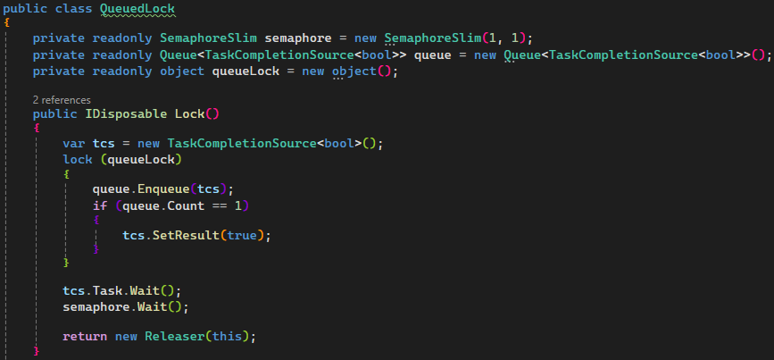
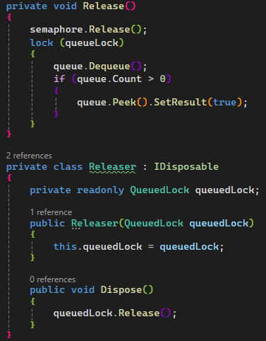
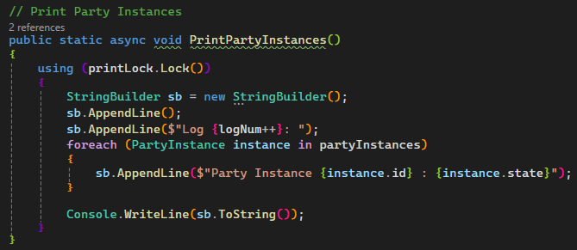
Deadlock Prevention
Queued Lock
Implementation
Queued Lock
Usage inside using() scope

Slide 5
Starvation Prevention
If a thread finishes fast enough, it is possible for it to hog all the resources, causing the other threads to starve
Especially the case for naïve looping implementations
Synchronization Mechanism:
Application uses a round robin dispatcher to prevent starvation between the threads
It loops through all the threads sequentially and checks if they can host a party
If possible, then allocate party. If not, then go to next and check if they can
Evenly distributes the parties based on who is available
Threads don’t need to compete against each other for resources

Slide 6
Starvation Prevention
Encountered old edge case of starvation:
Only occurs if finish time is always at 0 seconds
Old implementation used a regular lock instead of a queued lock
When thread requests for a lock and sees that it is acquired, it waits for some time before trying to request again
Because of this, if all the threads are active and a thread releases the lock, if the same thread finishes fast enough, it can request the lock and acquire it again while the other threads are still waiting to request again
Since the lock is a blocking lock, only the same thread will ever finish and dispatcher will repeatedly give parties to the this thread, causing all other threads never to finish and starve
Synchronization Mechanism:
Change the regular lock to a queued lock
Ensures each thread gets a turn with the lock
Technically, the lock itself also became a dispatcher???

Slide 7
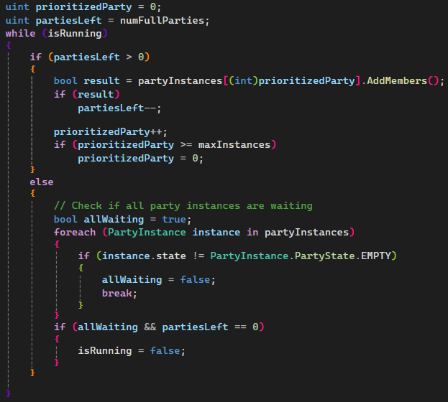
Starvation Prevention
Round Robin Dispatcher Implementation

Slide 8
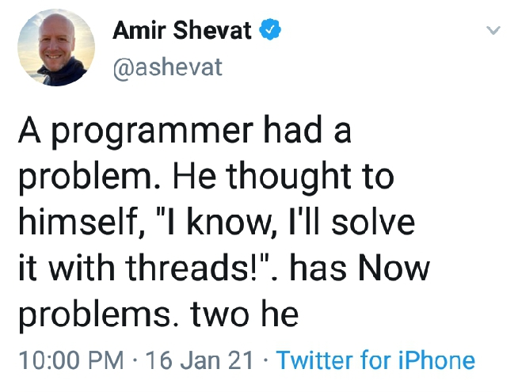
Thank You for Reading
Presented by: Tean Concio

